Slide 1
Chapter 2 Objectives
The CCNA Topics Covered in this chapter include:
  Standard ACL
  Configuration
  Examples of standard ACL

Slide 2
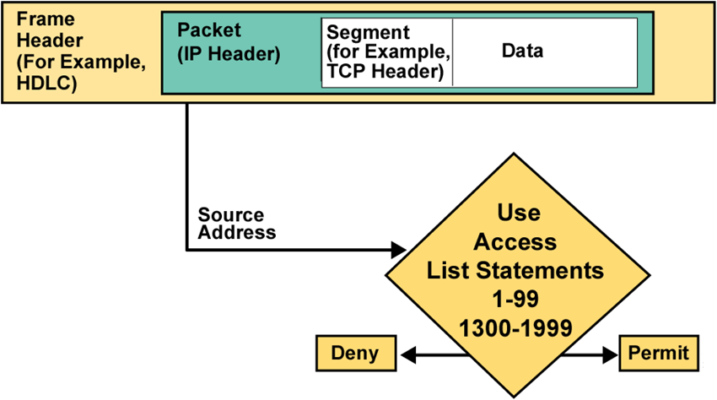
Testing Packets with Standard Access Lists

Slide 3
Standard IP Access Lists
    Router#config t
    Enter configuration commands, one per line. End with CNTL/Z.
    Router(config)#access-list ?
    <1-99> IP standard access list
    <100-199> IP extended access list
    <1000-1099> IPX SAP access list
    <1100-1199> Extended 48-bit MAC address access list
    <1200-1299> IPX summary address access list
    <200-299> Protocol type-code access list
    <300-399> DECnet access list
    <600-699> Appletalk access list
    <700-799> 48-bit MAC address access list
    <800-899> IPX standard access list
    <900-999> IPX extended access list

Slide 4
Standard IP Access Lists
Creating a standard IP access list:
    Router(config)#access-list 10 ?
    deny Specify packets to reject
    permit Specify packets to forward
Permit or deny?
    Router(config)#access-list 10 deny ?
    Hostname or A.B.C.D Address to match
    any any source host
    host A single host address
Using the host command
    Router(config)#access-list 10 deny host 172.16.30.2

Slide 5
Creating Standard ACL
From Global Configuration mode, type in:
access-list [access-list-number] [deny/permit] [source-ip-address] [ wildcard mask]
interface [interface-number] ip access-group [number of list] in/out
Example:
access-list 5 permit 11.0.3.0 0.0.0.255
access-list 5 permit 10.0.5.0 0.0.0.255
int fa0/0
ip access-group 5 out
Note: Implicit deny at the end of the statements

Slide 6
Wildcard Mask
Config# access-list 1 deny 192.168.1.0 0.0.0.255
Config# access-list 1 permit any
Access-list 99 permit 192.168.1.1 wildcard mask
All 32 bits of an IP Address can be filtered
Wildcard inverse mask
0=must match
1= ignore
MASK (192.168.1.1) | Matching IP
0.0.0.0 (host) | 192.168.1.1
0.0.0.255 | 192.168.1.0-255
0.0.255.255 | 192.168.0-255.0-255
0.255.255.255 | 192.0-255.0-255.0-255
255.255.255.255 | 0-255.0-255.0-255.0-255 (any)

Slide 7
The ANY and HOST keyword
Access-list 1 permit 0.0.0.0 255.255.255.255
Or
permit any
Access-list 1 permit 200.0.0.9 0.0.0.0
Or
permit host 200.0.0.9

Slide 8
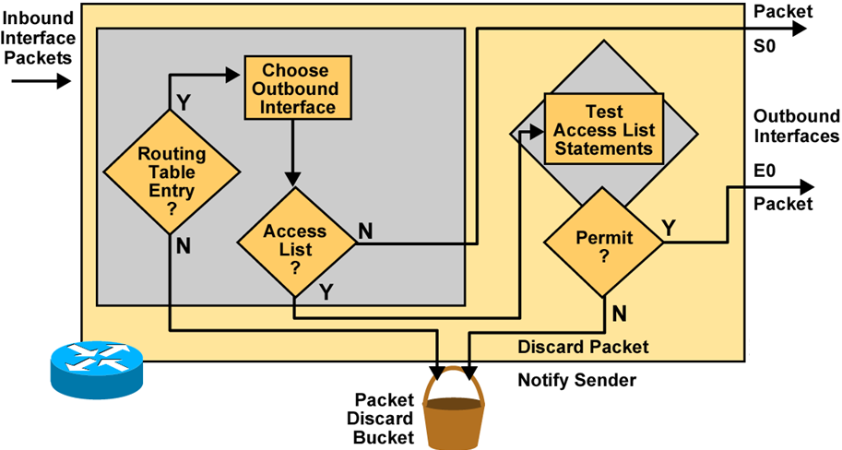
Outbound ACL Operation
  If no access list statement matches, then discard the packet.

Slide 9


Exercise – Standard Access List
192.168.0.5
255.255.255.252
192.168.0.9
255.255.255.252
Sales
Account
E0
R1
192.168.0.33
255.255.255.240
R2
R3
192.168.0.17
255.255.255.248
S0
S1
S0
E0
A
S0
192.168.0.10
255.255.255.252
B
192.168.0.18
255.255.255.248
192.168.0.6
255.255.255.252
192.168.0.34
255.255.255.240
Creating access list
R3(config)# access-list 1 deny 192.168.0.18 0.0.0.7
R3(config)# access-list 1 permit any
Applying access list
R3(config)#int e 0
R3(config-if)# ip access-group 1 out

Slide 10
Exercise – Standard Access List
Non 172.16.0.0
172.16.3.0
172.16.4.0
S0
E0
E1
Restrict Non 172.16.0.0 network from accessing either 172.16.3.0 or 172.16.4.0
R(config)# access-list 1 permit 172.16.0.0 0.0.255.255
R(config)# interface E0
R(config-if)# ip access-group 1 out
R(config-if)# interface E1
R(config-if)# ip access-group 1 out

